Slide 2
Chapter 1
Overview of Cloud Computing

Slide 3
Learning Outcomes
At the end of the session you will be able to:
Define cloud computing
Describe need of cloud computing
Describe history of cloud computing
Explain historical evolution of cloud computing
Describe benefits of cloud computing
Understand limitations of cloud computing
Explain elastic computing
Differentiate various vendors of cloud computing
Distinguish traditional data center and cloud data center

Slide 4
Introduction
Cloud computing is a technology which utilizes the Internet and central isolated servers in order to sustain applications and data.
This technology permits much more proficient computing by consolidating bandwidth, processing, and storage memory.
Cloud offers robust memory administration, thus there is no necessity to sustain memory on a personal system.

Slide 5
Definition of Cloud Computing
The term ‘cloud’ is defined by NIST [10] as follows:
“Cloud computing is a model for enabling ubiquitous, convenient, on-demand network access to a shared pool of configurable computing resources (e.g., networks, servers, storage, applications, and services) that can be rapidly provisioned and released with minimal management effort or service provider interaction. This cloud model is composed of five essential characteristics, three service models, and four deployment models.”

Slide 6
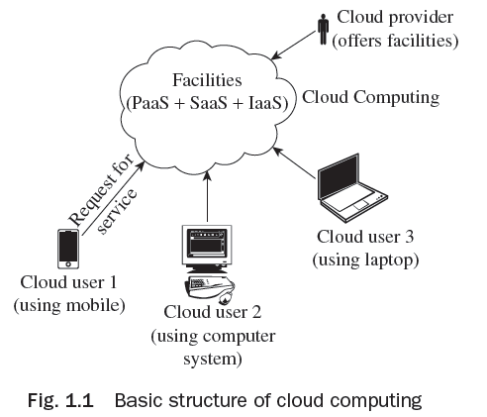
Basic Structure of Cloud Computing
The basic structure of cloud computing is
shown in Fig. 1.1. As given in the figure,
facilities and services are offered by cloud
providers in a cloud computing environment
and different users from various locations
and devices can request for specific services
that are offered.

Slide 7
Basic Structure of Cloud Computing
Some of the benefits of cloud computing are given here:
It improves parallelism and allocation of resources for fast accessing.
One may acquire software services, networked storage space, computer resources, and various other services at a single place.
An additional company hosts a set of applications, get software renewals (with no charge), and so on.
It improves monetary burden such as operational expenses, renewing charge, and capital expenses.

Slide 8
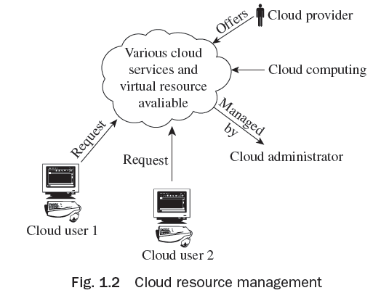
Cloud Resource Management

Slide 9
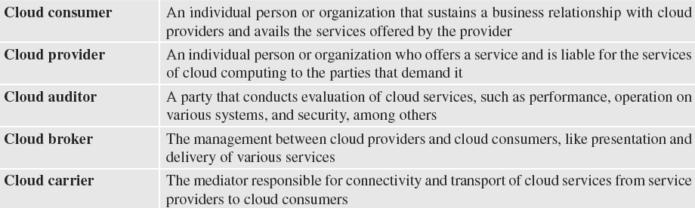
Terminology used in Cloud Computing

Slide 10
Need of Cloud Computing
Cloud computing is a new trend in computing due to its many benefits:
Reduced Costs
Scalability
Remote Access
Disaster Relief
Ease of Implementation
Skilled Vendors
Response Time
Easy to Customize
Virtual Provisioning
Fully Automated Storage Tiering—FAST

Slide 11
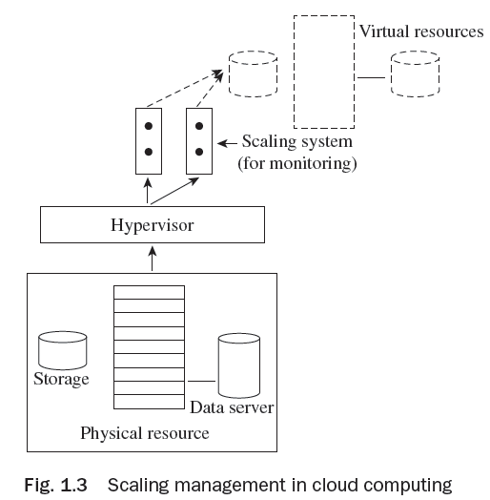
Scaling Management in Cloud Computing
One of the biggest advantages of cloud computing is that
a business pays only for the services it avails.

Slide 12
History of Cloud Computing
The historical evolution of Cloud Computing is as follows:
Client-Server Technology
Peer-to-Peer Approach
Distributed Computing
Evolution of Cloud Computing from Grid Computing
Autonomic Computing
Platform Virtualization
Service Oriented Architecture—SOA
Utility Computing
Web 2.0
Parallel Computing

Slide 13
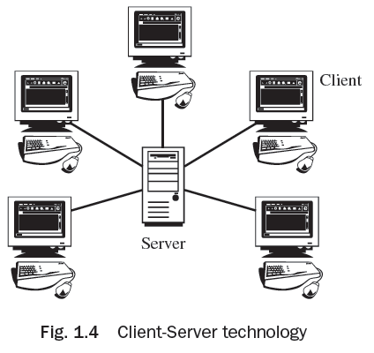
Client-Server Technology
Client-Server is the technology behind cloud computing. It is shown in Fig. 1.4. In this, multiple computers perform collectively to augment computing power.
The server is the prime regulator wherein software applications and data are kept for access.
The client is simply a tool which is associated with
the user for facilitation.
Due to inadequate processing power, IT employees
neither acquire instant access nor can two users
access similar data concurrently in client–server
technology.

Slide 14
Peer to Peer Approach
Peer-to-Peer (P2P) is a decentralized approach and it encompasses no principal server. It is a design in which every computer has equal responsibilities and facilities.
P2P facilitates straight swap of services and resources.
This kind of network is not simple to manage.

Slide 15
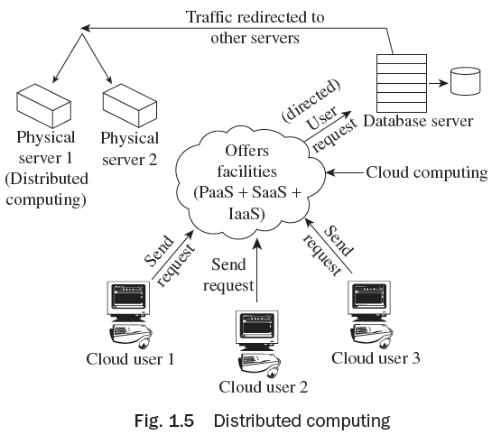
Distributed Computing
Distributed computing utilizes those idle resources that are not utilized for some reason or the other. Figure 1.5 shows distributed computing.

Slide 16
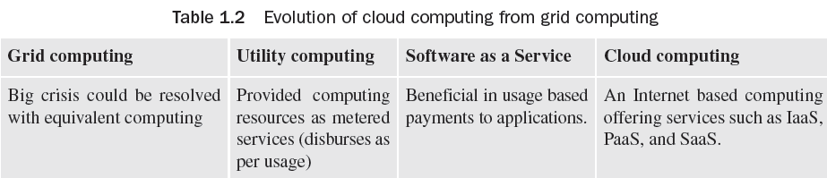
Evolution of Cloud Computing from Grid Computing

Slide 17
Web 2.0
Web 2.0 represents a change in technology in the world of the World Wide Web. It is usually designed to increase data security and customization of application as per the requirement with improved functionality.
The important features of Web 2.0 are as follows:
Easy to access
User interaction and participation
Rich customization features
Easy communication through video chatting, instant messaging facilities, etc.
User-friendly writing tools and applications
Data management and analysis
Multimedia supporting tools
Web application and hosting

Slide 18
Parallel Computing
Parallel computing simultaneously uses various computing resources for solving a computational problem.
It is based on the principle that a single large problem is divided into small parts and parallely runs different parts on different machines.
Parallel computing supports applications that require processing of a large problem in a sophisticated way. Some of the examples are Big data problem, Data mining, Search engines, Medical diagnosis, Virtual reality, Multimedia.

Slide 19
Services Provided by Cloud Computing
Electronic Faxing
Voice on Clouds
Commerce on Clouds
Distributed Hosting on Clouds
Accounting and Online Banking

Slide 20
News on Cloud Computing
A mobile phone can be used to access services related to news.
Google Apps or Gmail is capable of seeking information via e-mail, rapidly from any tool. We can talk and work with partners or consumers without any language barrier.
Distribution and editing of data with trouble-free collaboration using Google items Docs and Sites. TripIt is a private travel that assists in arranging tours. Data is gathered from consumers and colleagues by using Google types. There is joint work on a general venture.
Through Force.com, you may construct a scalable business application on the cloud platform.
Both Google’s cloud and salesforce.com computing platforms are employed to generate
business and web applications.
Using online patterns for presentations, spreadsheets, and records.
Functioning steady, safe, and quick Web apps.
Easily and firmly distributing video in apps through Youtube for Google apps.

Slide 21
Benefits of Cloud Computing
Cloud computing offers the following benefits:
Pay as per use
Reduced investment and proportional costs
Accessibility from anywhere
Increased scalability
Increased availability and reliability
Dynamic provisioning

Slide 22
Limitations of Cloud Computing
Some of the limitations of Cloud computing are:
Availability of Services
Data Lock-in
Data Segregation
Privilege Neglect
Scaling Resources
Data Location
Deletion of Data
Recovery and Backup
Offline Clouds
Unpredictable Performance

Slide 23
How to develop Cloud Computing
For the development of cloud infrastructure, the following are needed:
Understanding the prevailing conventional data center
Computing resources that will be virtualized
Installing service administration devices

Slide 24
Core Components of Traditional Data Centers
Application Program employed to carry out numerous computing functions. It may be an operating system, DBMS, and many more.
DBMS It is an administration system which offers the ability to save or get data from rationally prepared tables.
Compute Resources which work numerous applications using various elements.
Storage This is used to save data for often use.
Network It is the ability to communicate among systems. It assists us to share data and resources.

Slide 25
Vendors of Cloud Computing
Amazon Web Services—IaaS
Google—SaaS, PaaS
Microsoft Azure Service Platform—PaaS
Rackspace—Cloud Hosting
Salesforce.com—SaaS, PaaS

Slide 26
Elastic Computing
Elastic computing is the capability of a cloud service supplier to provision flexible computing strength when and where required.
In cloud computing, elasticity is described as the level to which a system is capable of adapting to workload variation by offering and taking back resources the autonomic way; at every point in time the accessible resources meet the present need.

Slide 27
Social Networking
Social networking may be done for business purposes, social purposes, or both.
Examples of social networking include LinkedIn, Facebook, etc..
A social networking website is an online podium which permits customers to build a public profile and interact with other users on the website.
Some social networking websites like LinkedIn are used for creating professional links, whereas sites such as Facebook are on both sides of the line (i.e., professional and private).

Slide 28
Enterprise Cloud Computing
Enterprise cloud computing is the process of using cloud computing for saving cost and for business innovation by getting extraordinary speed and agility, and improved collaboration among customers and business partners. Enterprise cloud computing is important because:
Cost of accessing data can be reduced to a great extent by linking it directly with the usage. Customers are charged on a pay-per-use basis.
Start-ups can test out new business ideas risk-free and at low cost, due to enormous scalability. Since there is no upfront capital expense involved, in case a new project takes off, it can be scaled up instantly, and vice versa.

Slide 29
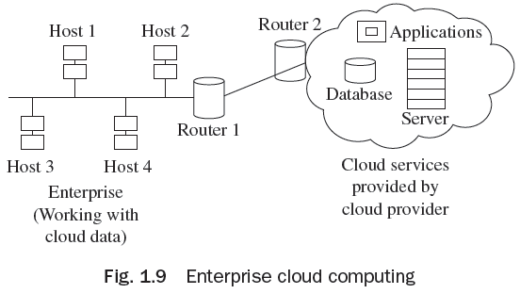
Enterprise Cloud Computing
Enterprise cloud computing allows a company to create a shared workspace in order to collaborate with its trading partners and work together as a ‘virtual enterprise network’. In this way, they can share the information and communication resources, without actually owning it all. This also helps in lowering costs. As shown in Fig. 1.9, an
enterprise with n numbers of hosts can connect
through cloud services and different types of
services supported by cloud network such as
database, servers, and various applications.

Slide 30
Thank You!

